Slide 1









Innovations in Medicine

Slide 2







Meet Our Team
Maram Sliti
Meriem Mojaat
Melek Hadriche
Nour Amorri
Sarra Boujday
Mouheb Hidouri

Slide 3



Outline
Business Understanding & Data Understanding
Business & Data Science Goals
Datawarehouse Modeling
Kpis
Dashboards
Demo Video
ML Data Science Objectives
3

Slide 4




Business Understanding
7

Slide 5







Decision Makers
Healthcare Organizations
Chief Executive Officer
Medical Department Heads
Chief Financial Officer
6

Slide 6
Data Understanding
7

Slide 7

EDA Phase

Slide 8
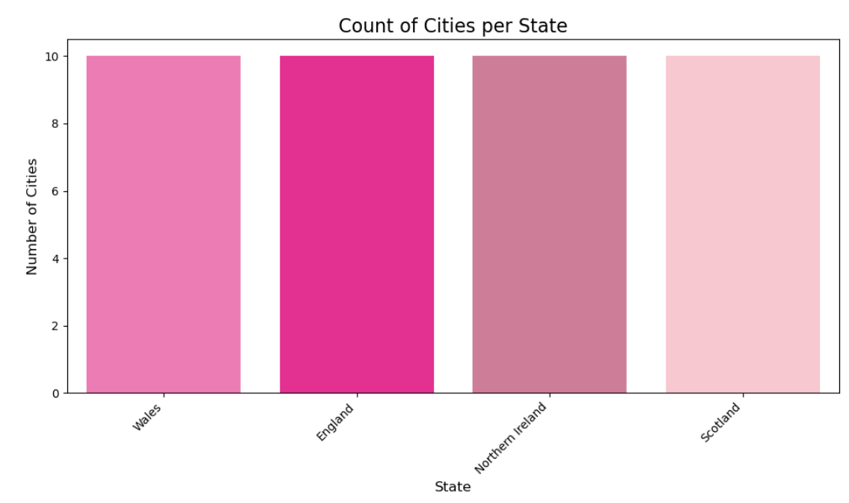
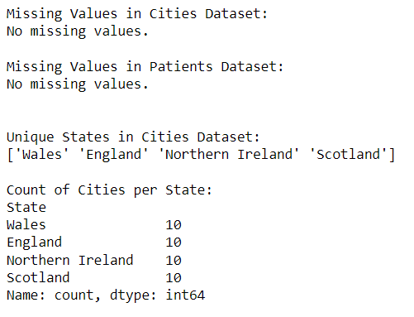
9

Slide 9
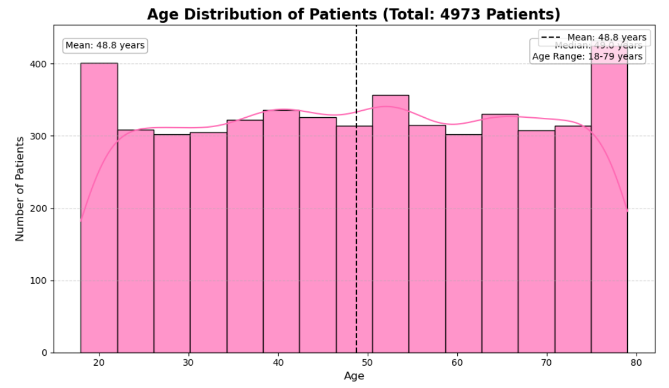
10

Slide 10
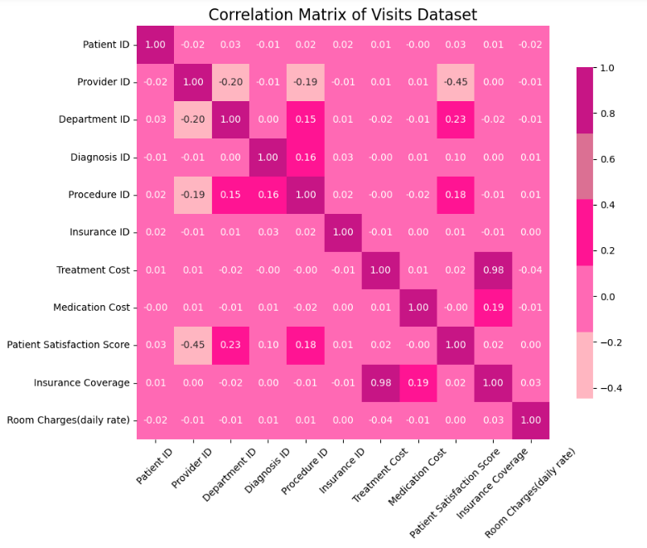
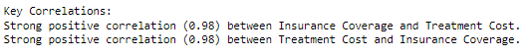
11

Slide 11
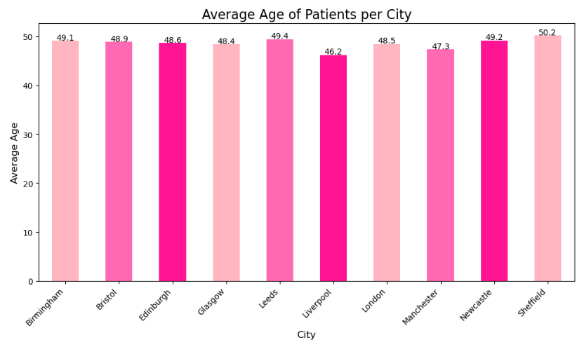
12

Slide 12

Business Goals

Slide 13

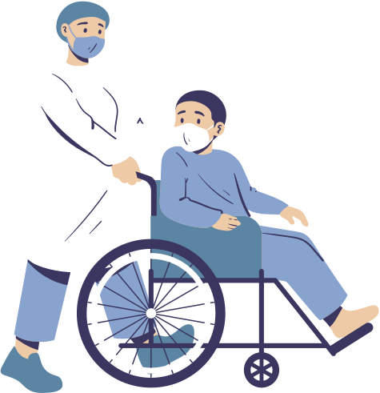
Business Goals
Enhance Patient Care
Increase Financial Performance
Improve Patient Satisfaction
Optimize Resource Allocation
14

Slide 14
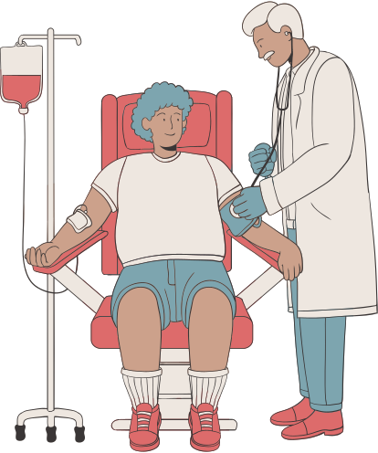
Data Science Goals

Slide 15

Data Science Goals
Increase total revenue
per visit
Identify high-risk
patient groups
10%
Increase Average Patient Satisfaction Score
Enhance cash flow.
95%
16

Slide 16

Datawarehouse
Modeling

Slide 17
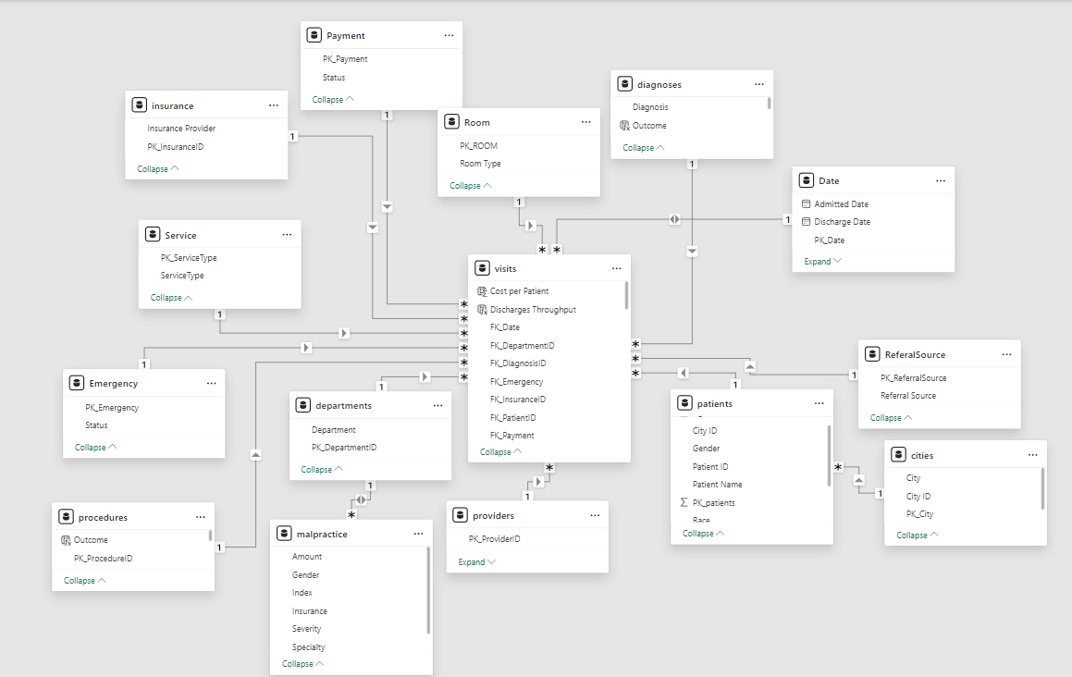
18

Slide 18
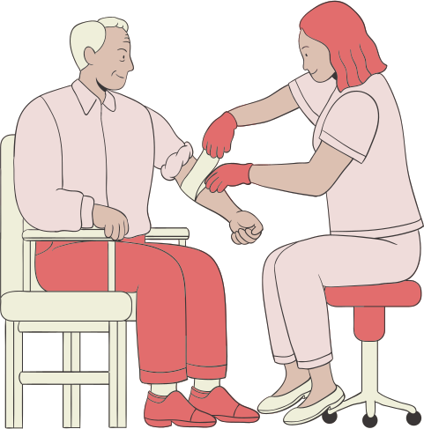
Key Performance Indicators

Slide 19
1. Patient Care KPIs
Follow-Up Visit Rate
Average Treatment Cost per Patient
Emergency Visit Rate
20

Slide 20
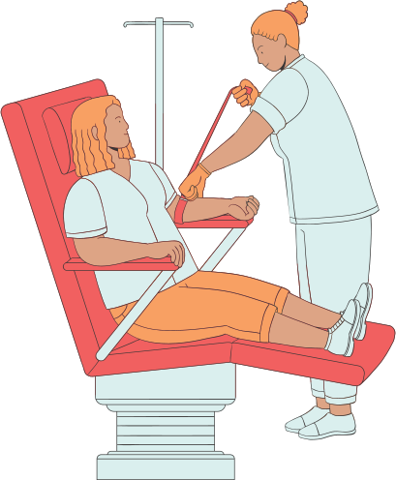
2. Operational Efficiency KPIs
Bed Occupancy Rate
Average Length of Stay
Procedure Utilization Rate
Patient Throughput
21

Slide 21

3. Financial Performance KPIs
Total Revenue per Visit
Treatment Cost per Procedure
Average Revenue per Provider
22

Slide 22
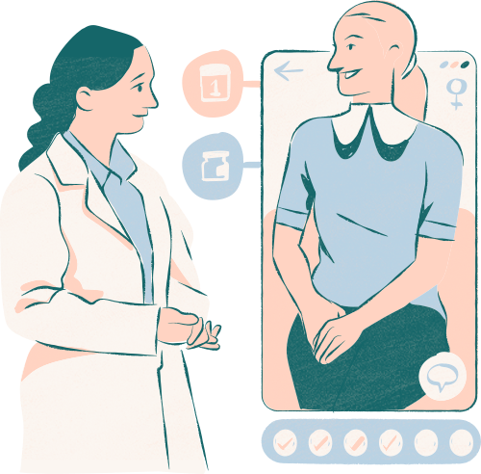
4. Provider Effectiveness KPIs
Diagnosis Accuracy Rate
Procedure Success Rate
23

Slide 23
Dashboards

Slide 24
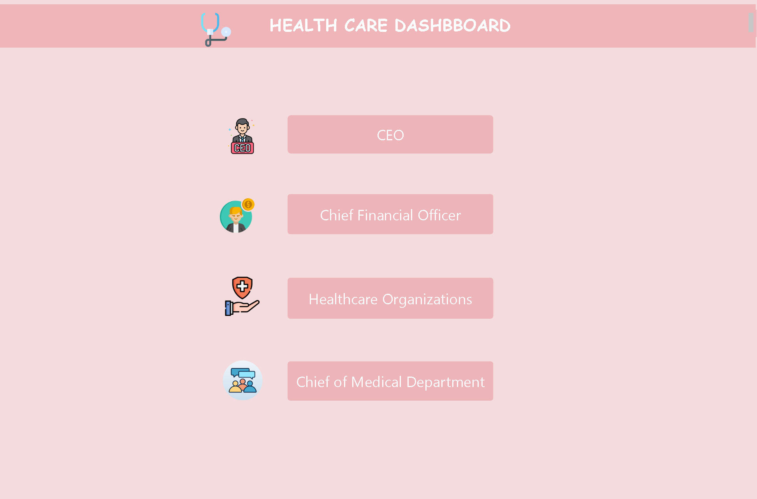
MENU
25

Slide 25
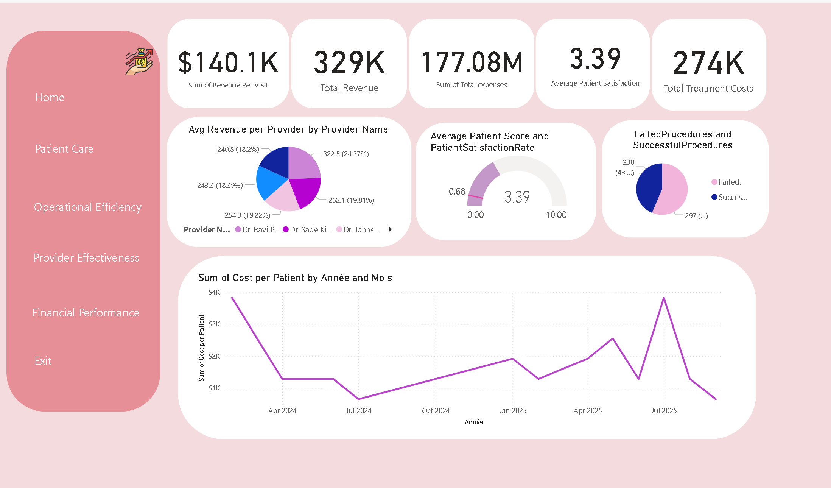
CEO DASHBOARD
31

Slide 26
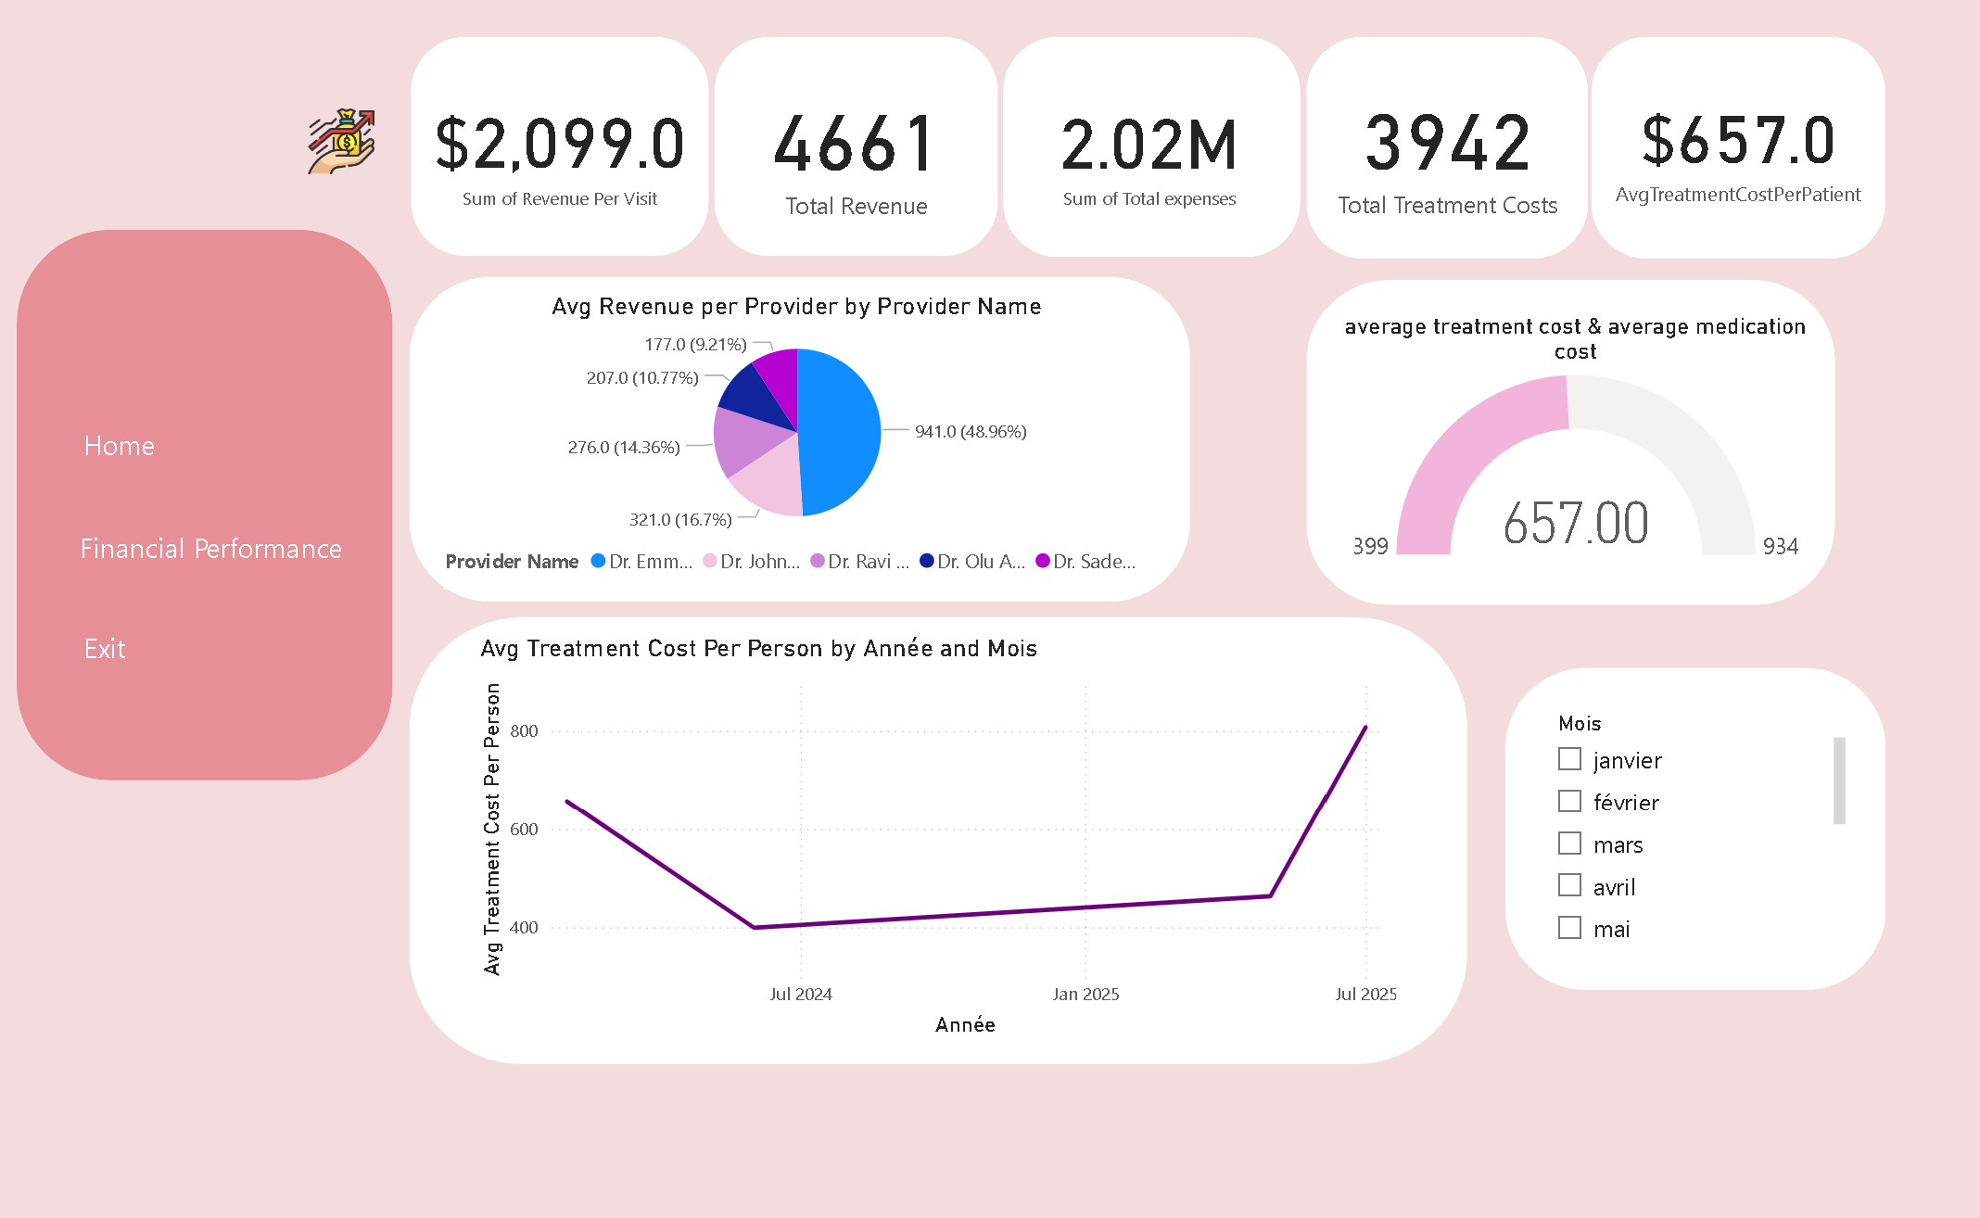
CFO DASHBOARD
32

Slide 27
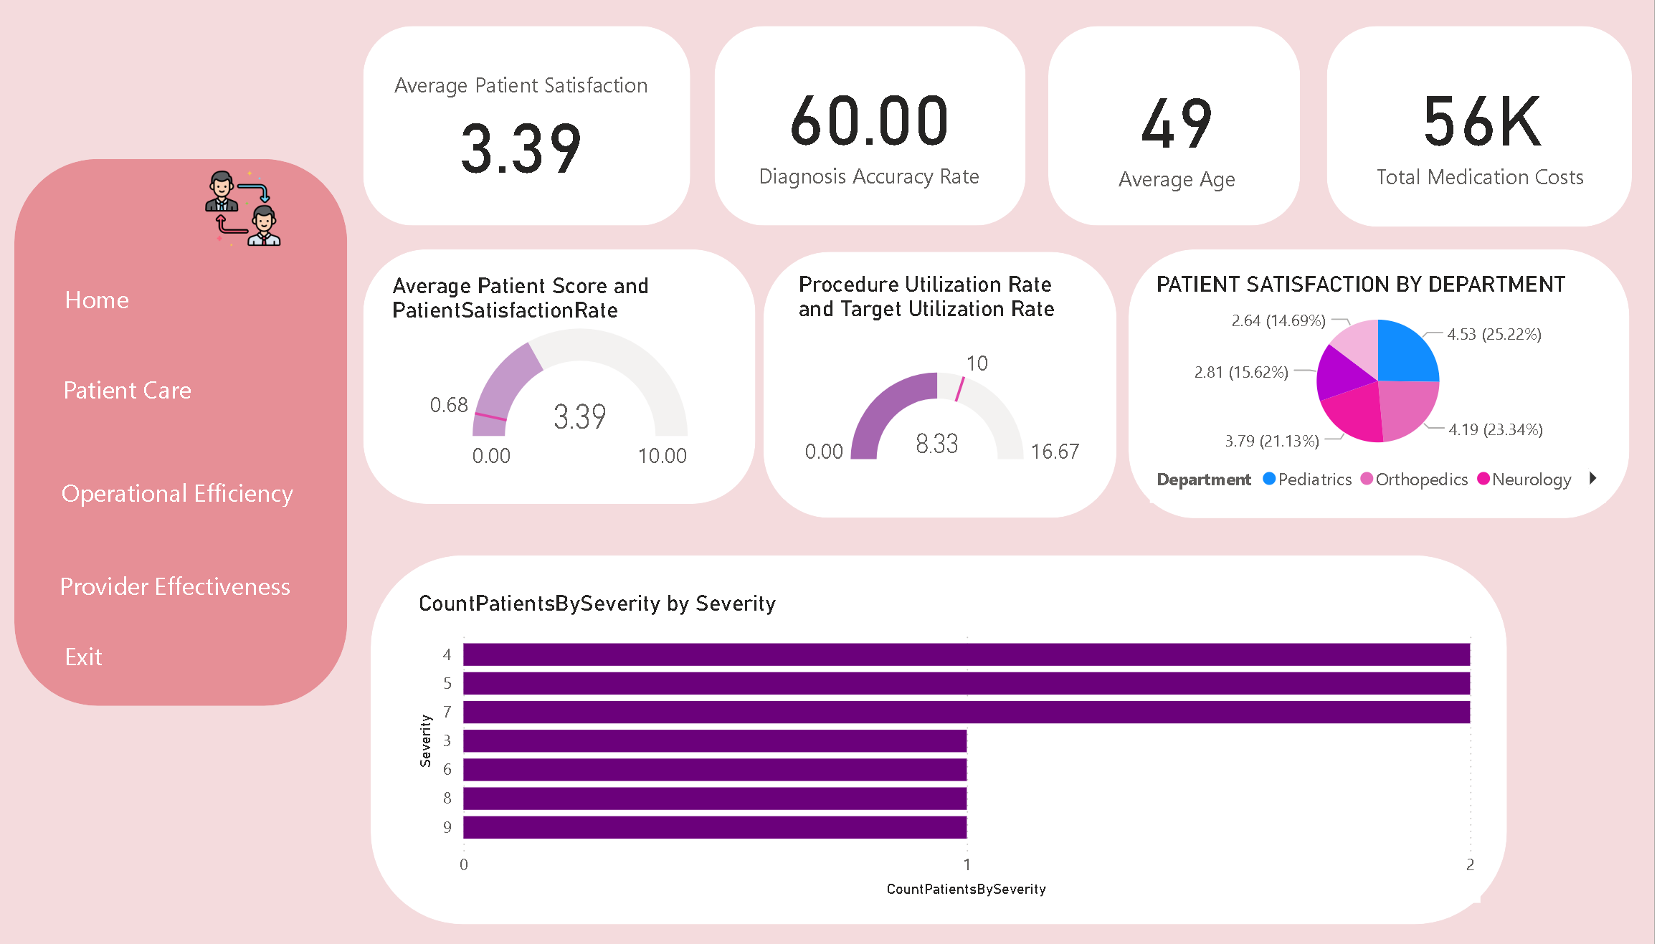
HEALTHCARE ORGANIZATIONS DASHBOARD
33

Slide 28
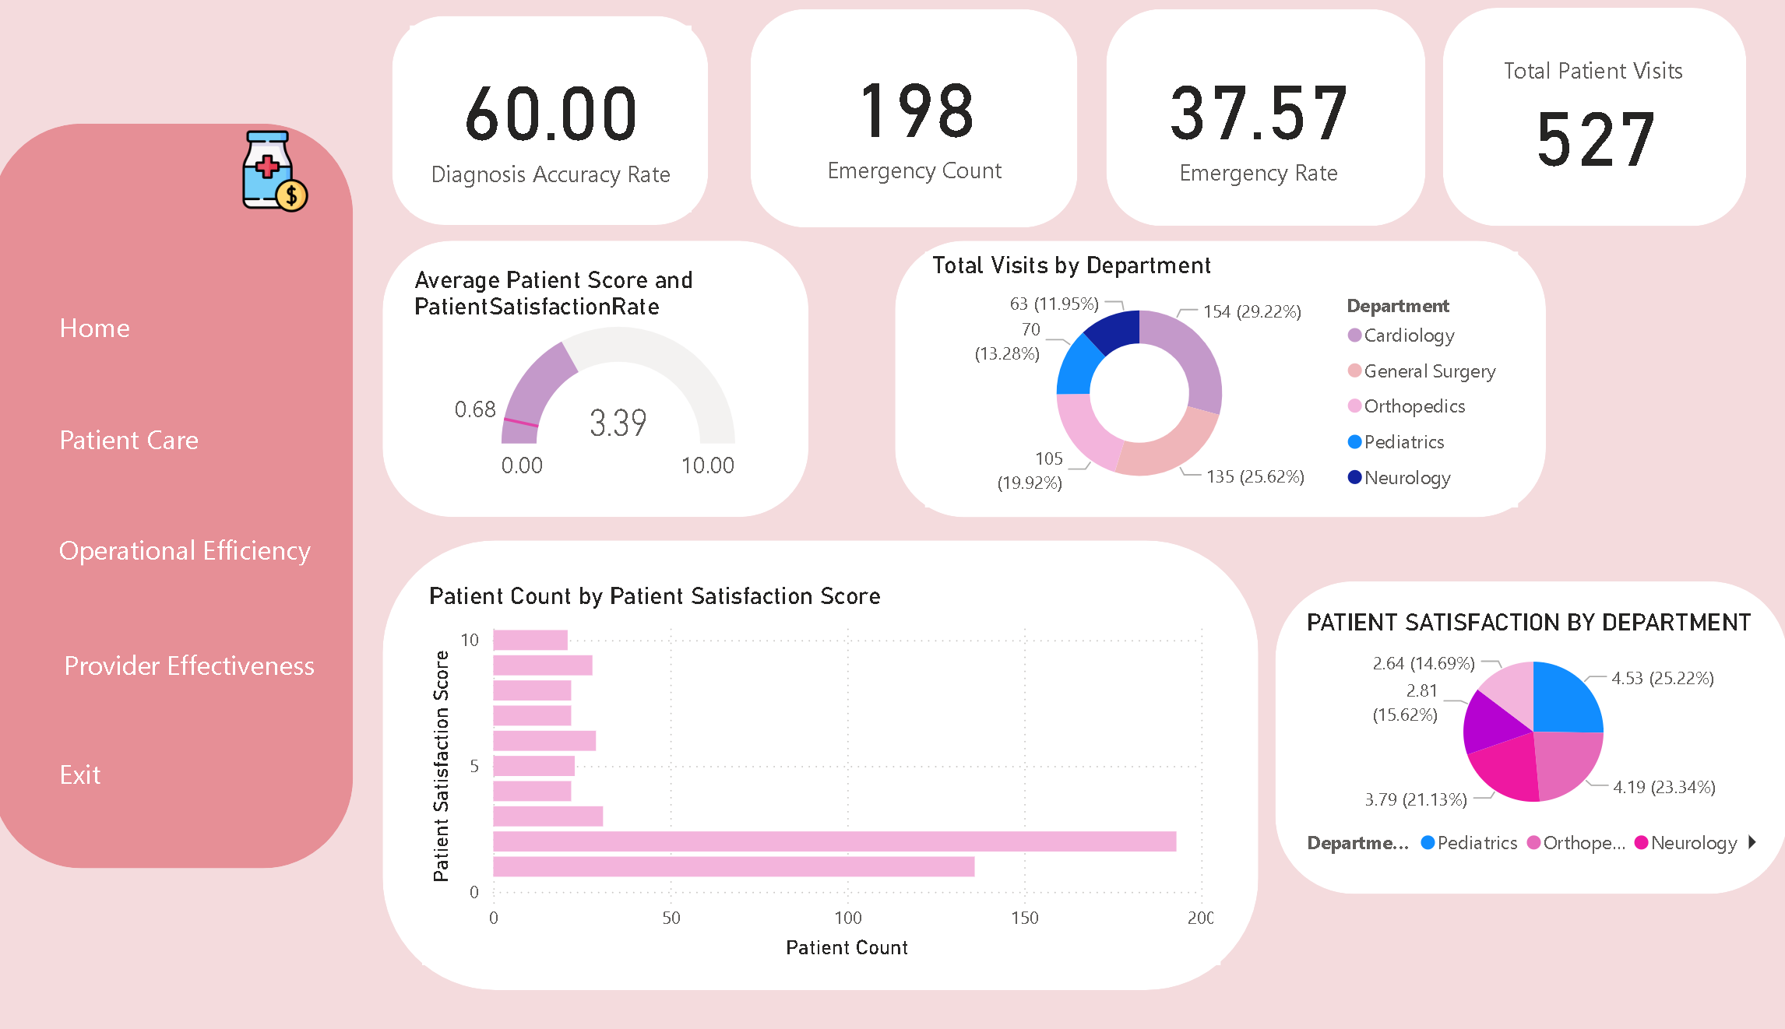
CHIEF OF MEDICAL DEPARTMENT DASHBOARD
33

Slide 29
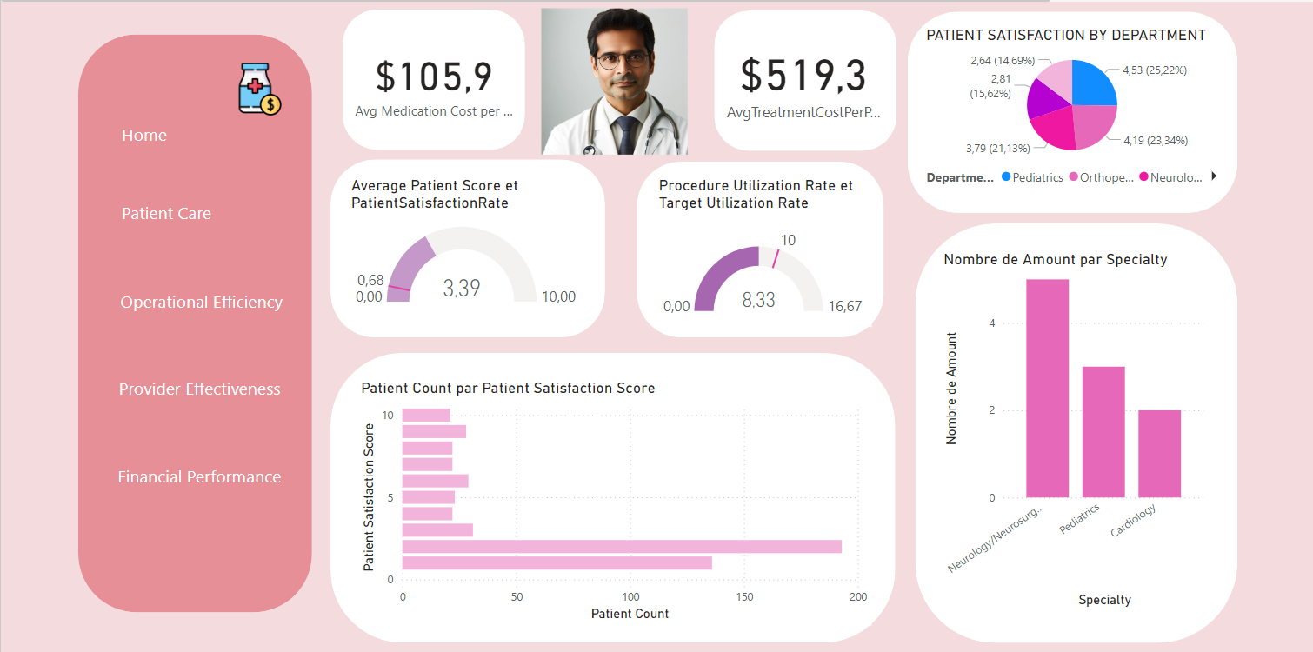
Operational Efficiency
28

Slide 30
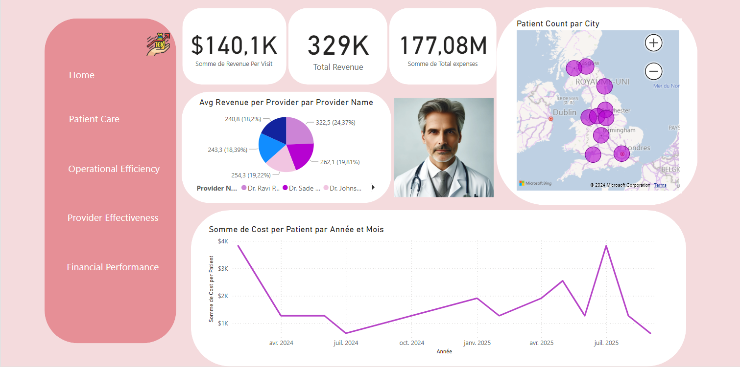
Financial Performance
30

Slide 31
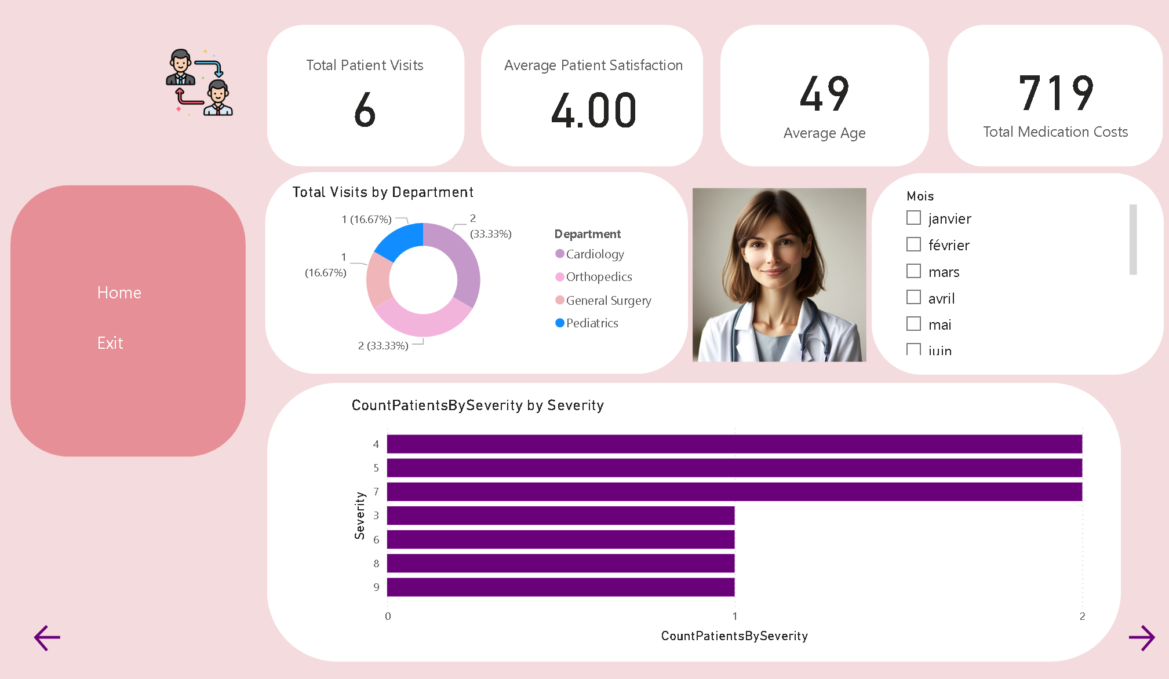
Patient Care 1
26

Slide 32
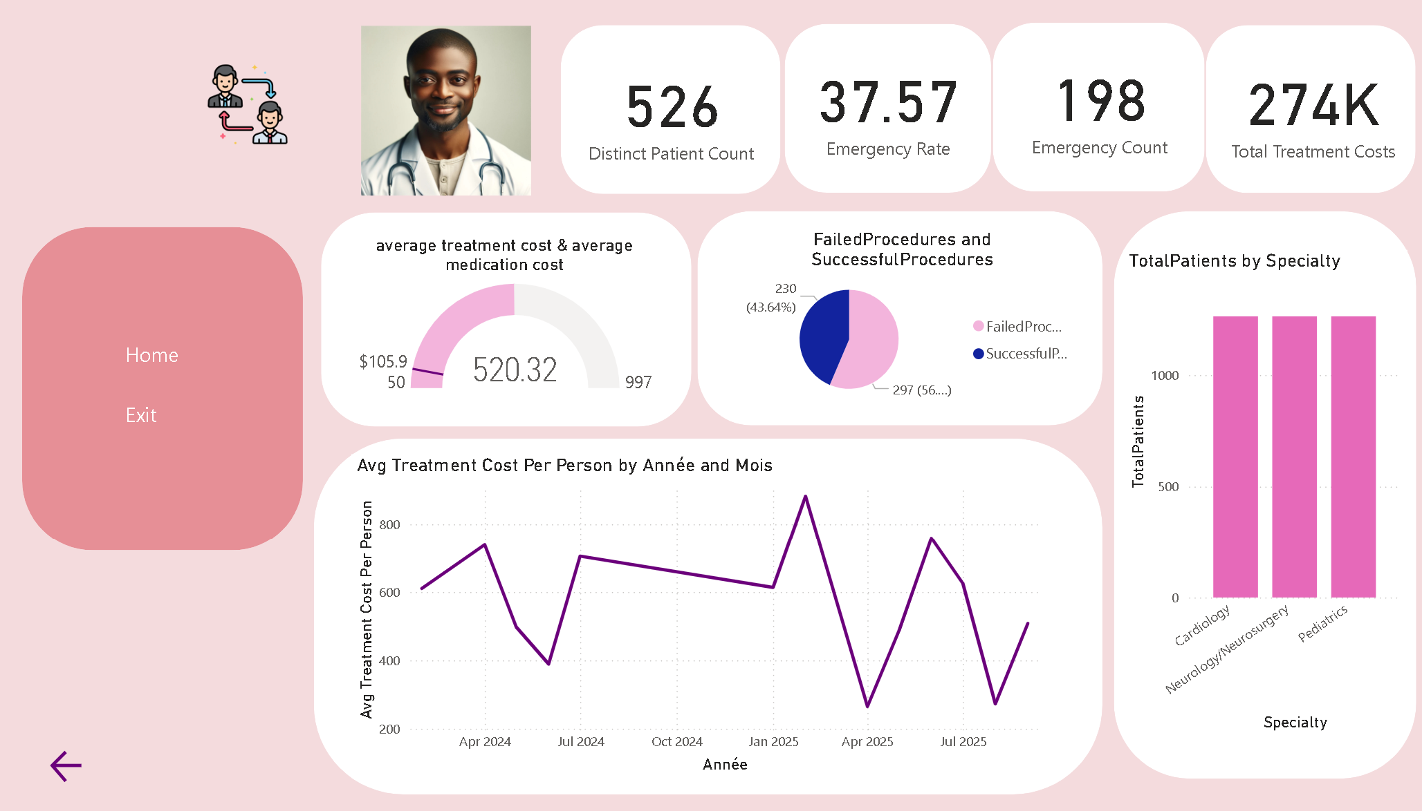
Patient Care 2
27

Slide 33
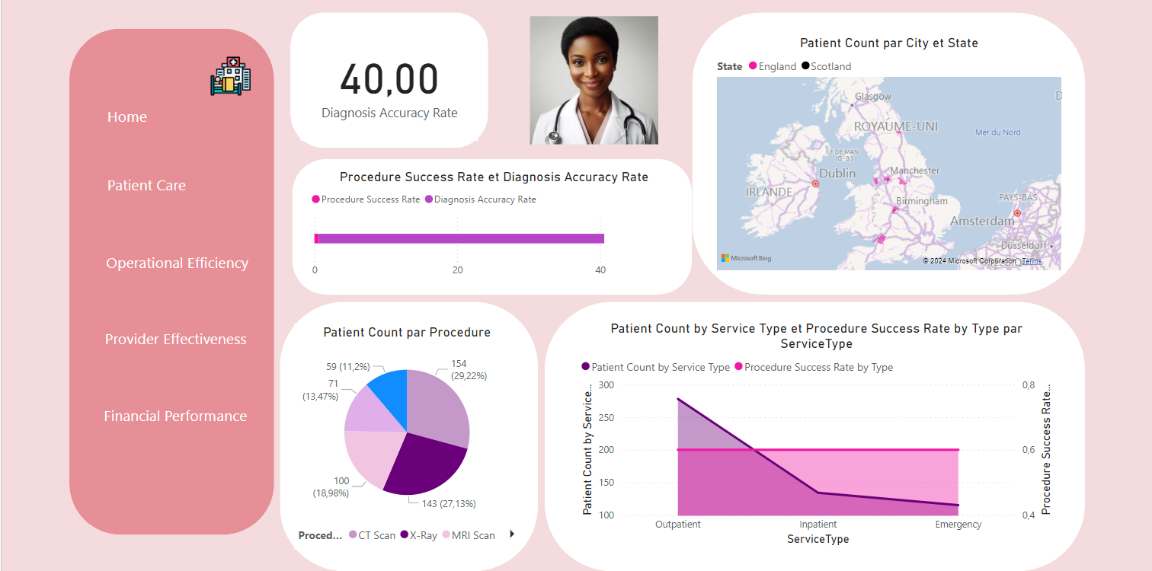
Provider Effectiveness
29*

Slide 34
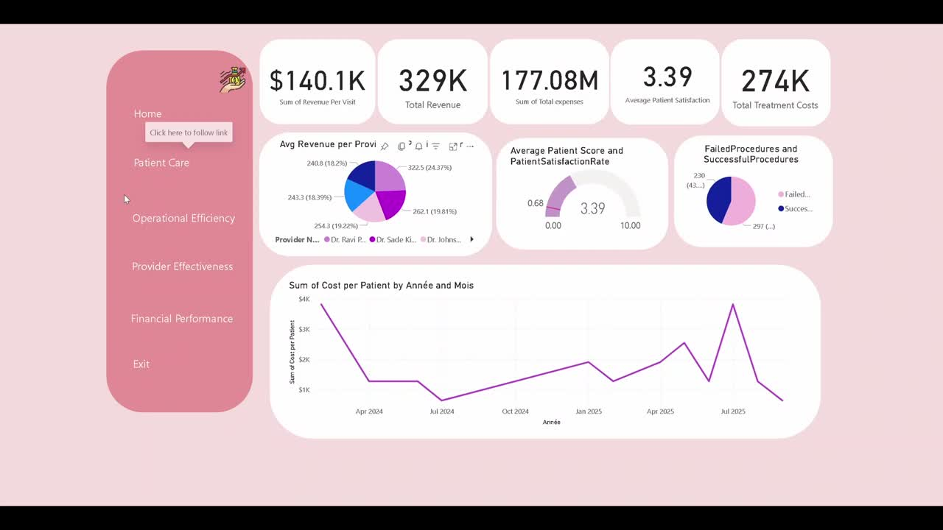
Demo Video
34

Slide 35
ML Data Science Objectives

Slide 36
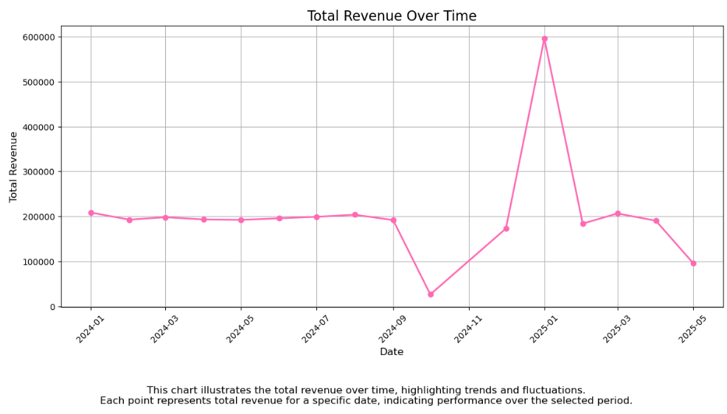
EnhanceCashFlow
35

Slide 37
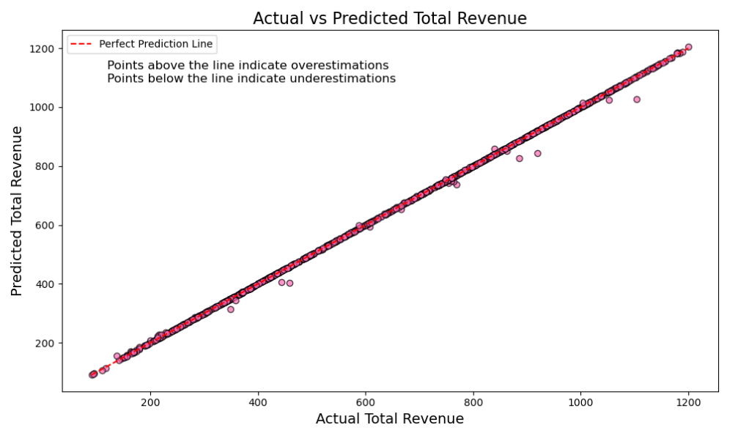
EnhanceCashFlow
36

Slide 38
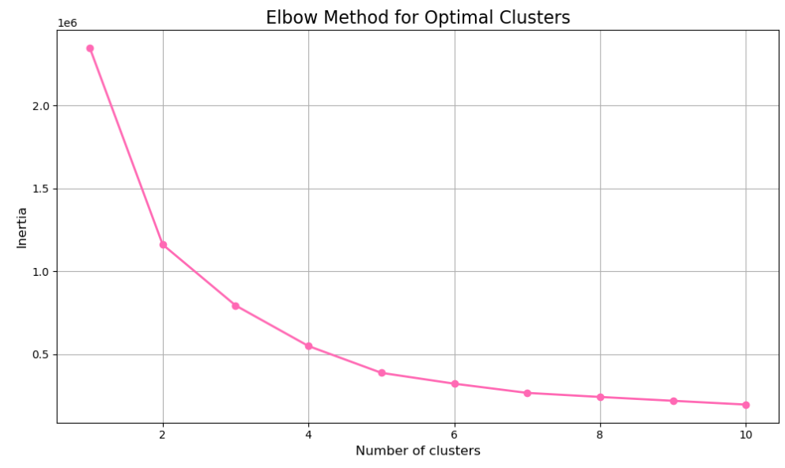
Identify High-Risk Patient Groups
37

Slide 39
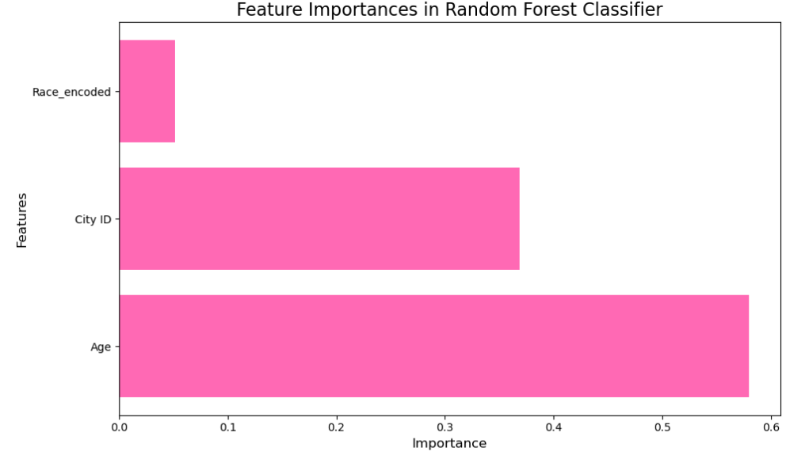
Identify High-Risk Patient Groups
38

Slide 40
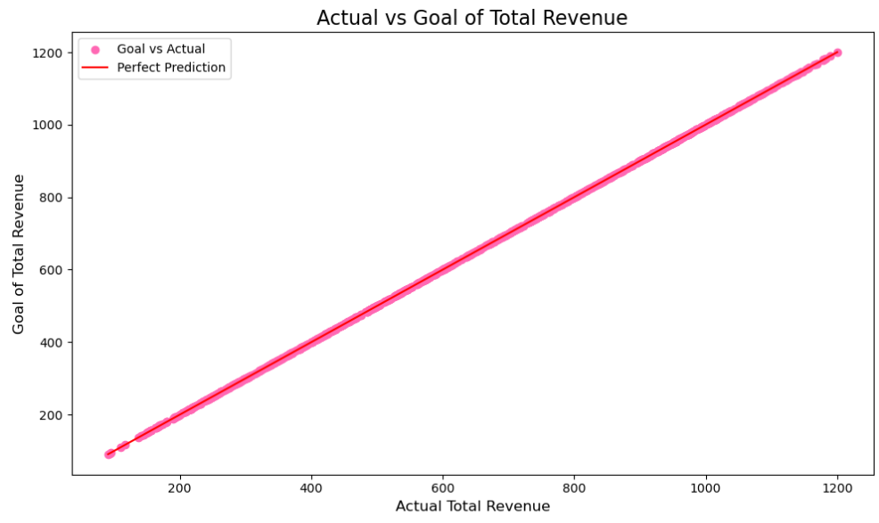
Total revenue per visit
39

Slide 41
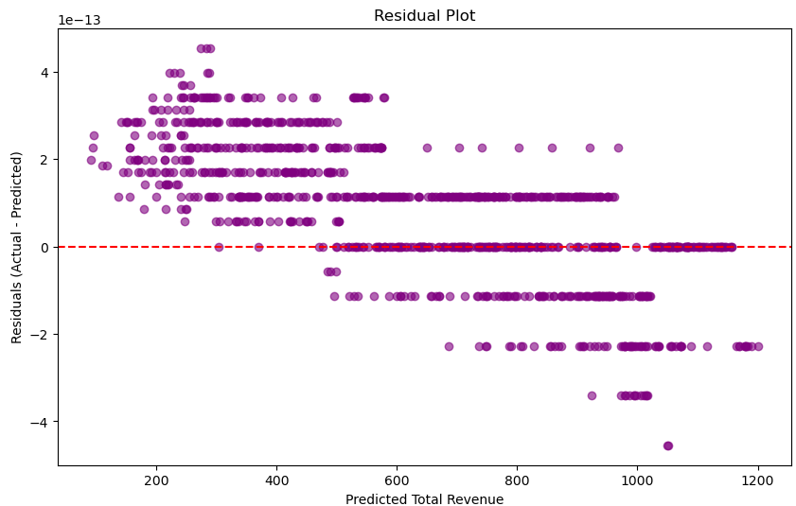
Total revenue per visit
40

Slide 42
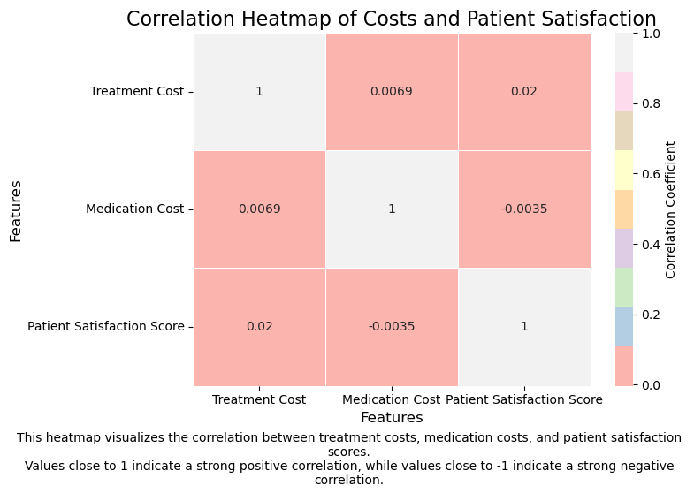
Patient Satisfaction Score
41

Slide 43
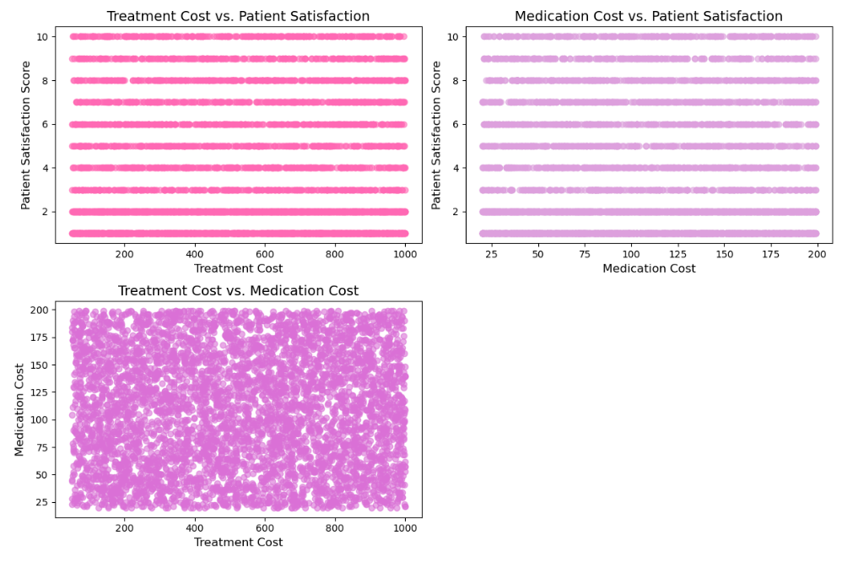
Patient Satisfaction Score
42

Slide 44


Conclusion

Slide 45

Thank you for your attention

